Slide 1

College Scorecard ANALYSIS USING HIVE
Presented By:
Aditya Patil

Slide 2
Table of content
What is BigData
College Scorecard
What is our Project
What technology we used
SDLC
Hive Queries
Graphs and Final Results
Conclusion
Github and Data Source
References

Slide 3
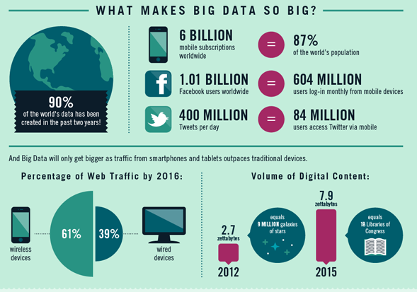
BIG DATA IN AROUND THE WORLD

Slide 4
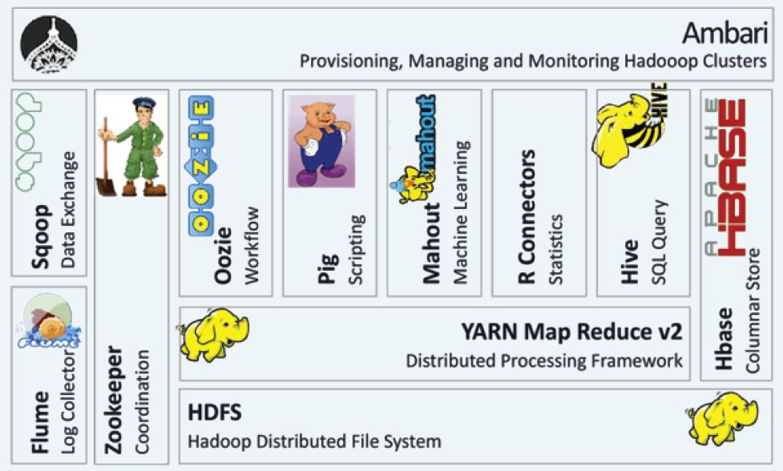
BIG DATA ECO-SYSTEMS

Slide 5








A Application Of Big Data analytics
Smarter Healthcare
Sales
Homeland
Security
Telecom
Traffic Control
Analytics
Search
Quality
Manufacturing

Slide 6
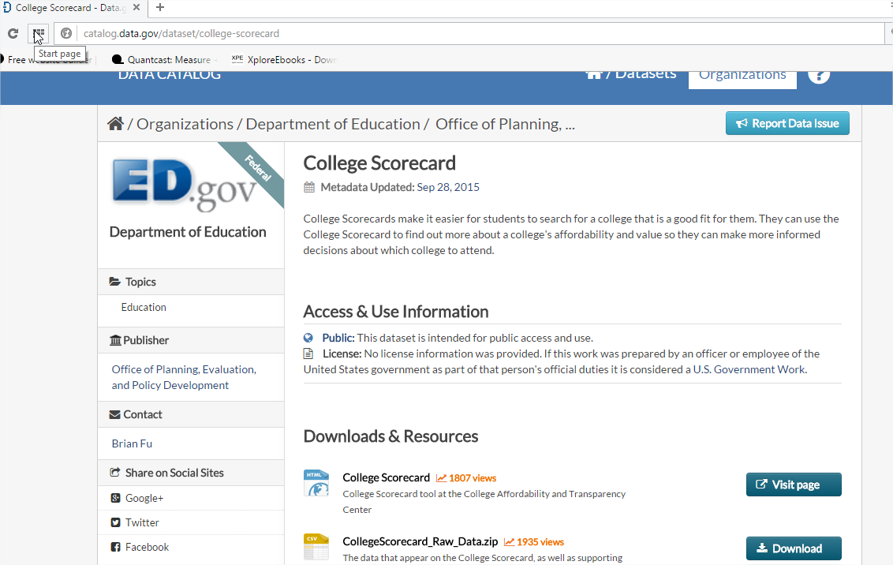
Data Set Source -
http://catalog.data.gov/dataset/road-traffic-injuries-2002-2010

Slide 7
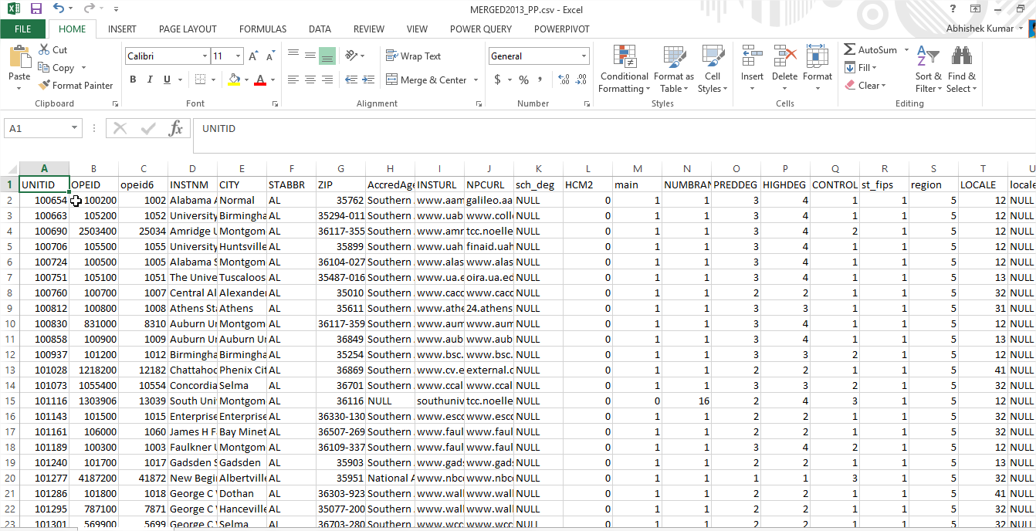
THE RAW DATA

Slide 8
College Scorecards make it easier for students to search for a college that is a good fit for them. They can use the College Scorecard to find out more about a college's:
Popular Colleges among students
Affordability
Net Price
No of enrollments
State with Most number of University

Slide 9
Technologies What have we used
Microsoft Power BI
Apache Ambari - Version 2.1.2
Hortonworks Sandbox with HDP 2.4
HIVE
Microsoft Excel
Putty - Release 0.65
Google Fusion Table

Slide 10
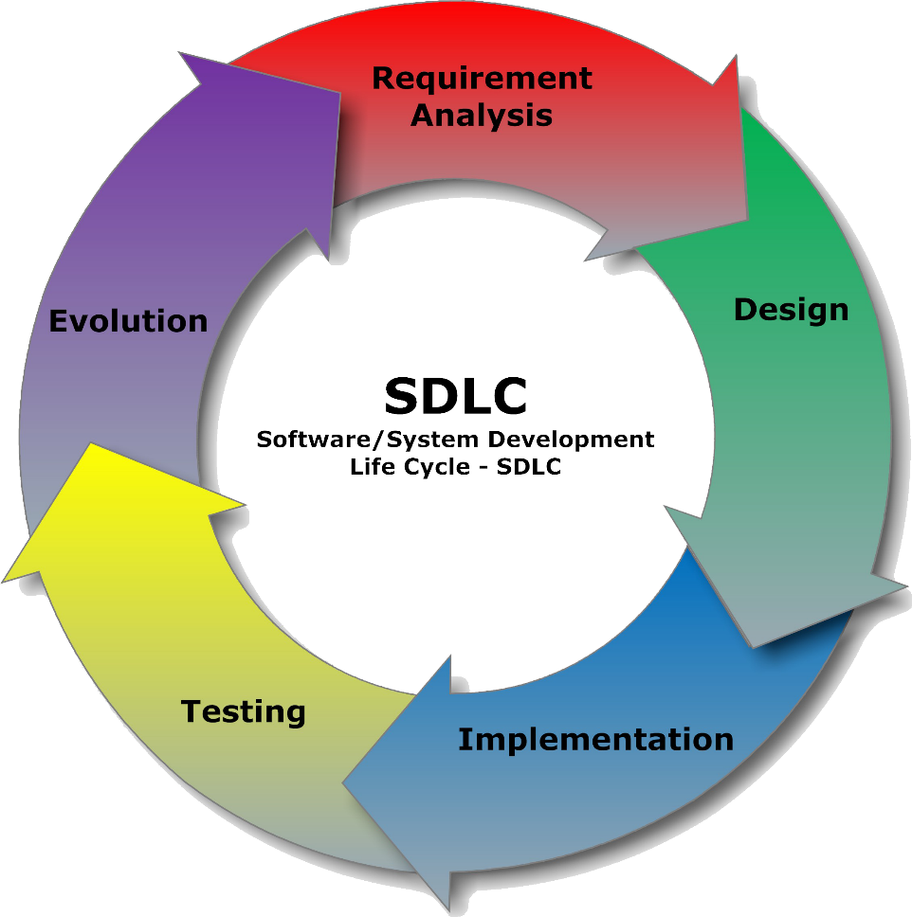
System Development Life Cycle

Slide 11
System Development Life Cycle
Planning
Defined Scope
Analysis
Gathered data from Data.Gov
Design
Gathered required softwares such as Azure, Power View, Microsoft Power BI
Testing
Requirement Gathering
Time Estimation
Implementation
Developed Queries & Created Tables
Analysis made on the created Tables using graph and Map

Slide 12
What is our project
Data analysis is done on College Student Data
Cost of college Tuition Fee
Admission Rate
Popular Colleges
Popular States
Biggest Universities
Data analysis is done by using HDFS Cluster, HiveQL
Analyzed data will be displayed using MS Power BI & Power Query in the form of Graphs and Maps.

Slide 13
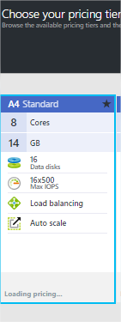
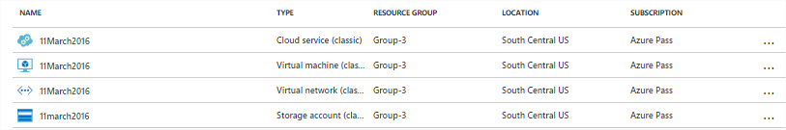
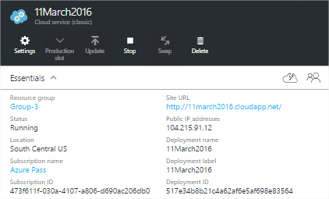
CREATING THE CLUSTER in SanDBOX

Slide 14
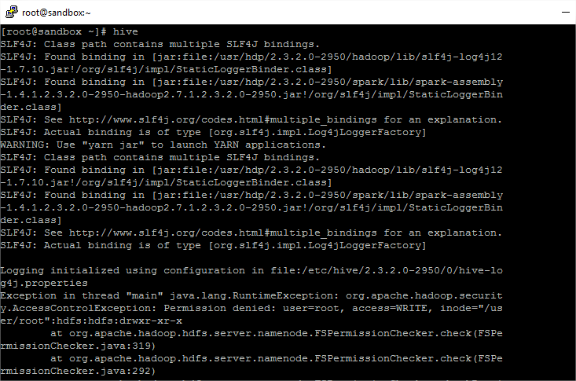
USING PUTTY TO LOGIN TO CLUSTER and CHECK HIVE STATUS

Slide 15
PROCESS OF Analysis
Step 1- Data CLEANING by removing unwanted an NULL column.
Step-2- LOADING Data to HDFS
STEP-3- Running HQL Queries
Steo-4-Saving results in CVS files
Step-5- Combining the results into one Excel file.

Slide 16
Flowchart OF DATA ANALYSIS
DOWNLOAD DATA FROM DATA.GOV
Uploaded the txt files into HDFS Using Ambari
Created tables using HiveQL
Analysis of Bar and line Graphs.
Analyzed data using the query, Microsoft BI and powerview

Slide 17
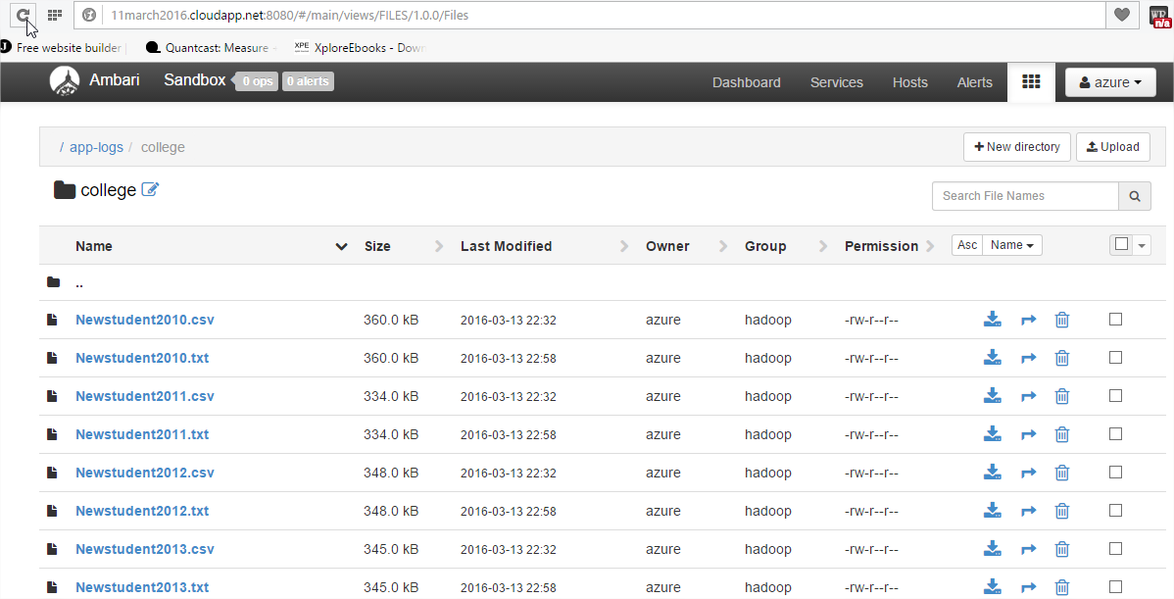
Data upload via Ambari
We have put data in HDFS using Ambari

Slide 18
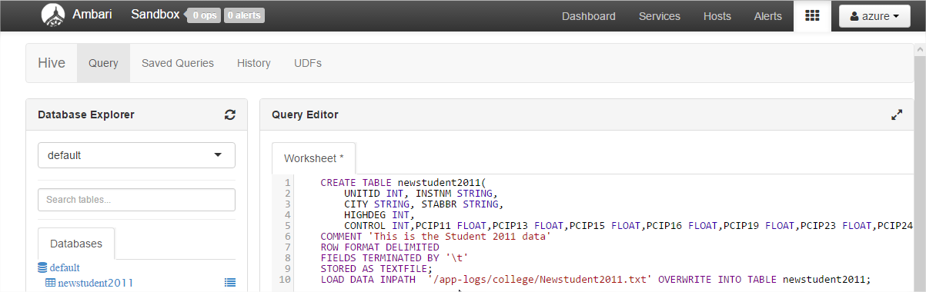
Creating the tables

Slide 19
CREATING A COST TABLE
CREATE TABLE newcost2011
UNITID INT, INSTNM STRING,CITY STRING,CONTROL INT,ADM_RATE FLOAT,ADM_RATE_ALL FLOAT,TUITFTE FLOAT,TUITIONFEE_IN FLOAT,TUITIONFEE_OUT FLOAT,COSTT4_A FLOAT, UGDS INT)
COMMENT 'This is the Student 2011 data'
ROW FORMAT DELIMITED
FIELDS TERMINATED BY '\t'
STORED AS TEXTFILE;
LOAD DATA INPATH '/tmp/newcost2011.txt' OVERWRITE INTO TABLE newcost2011;

Slide 20
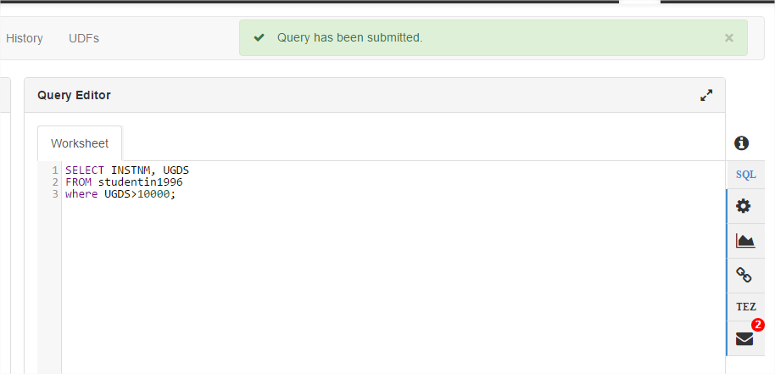
Output of QUERY

Slide 21
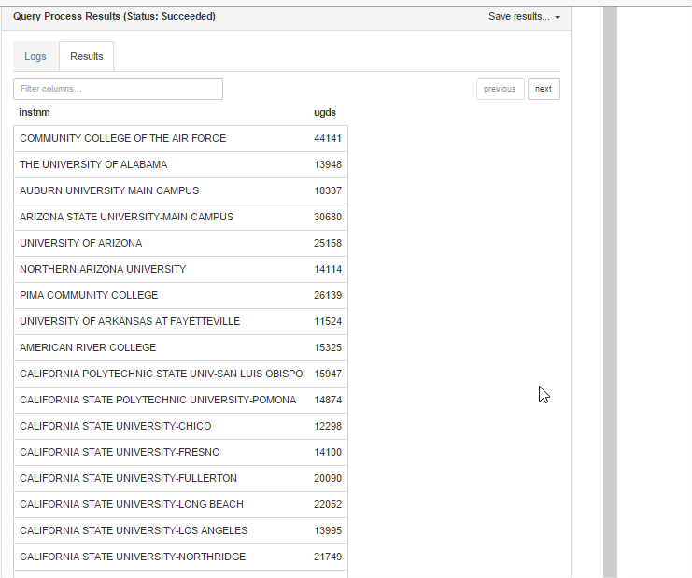
RESULTS of the QUERY

Slide 22
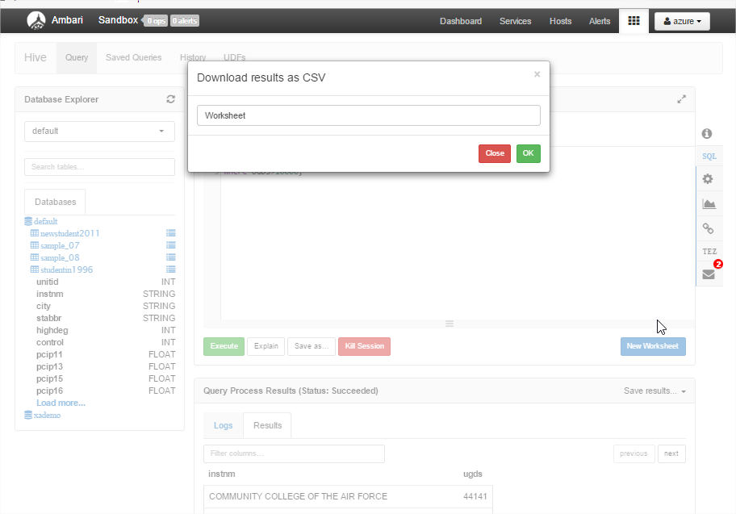
Downloading RESULTS into CSV FORMAT

Slide 23
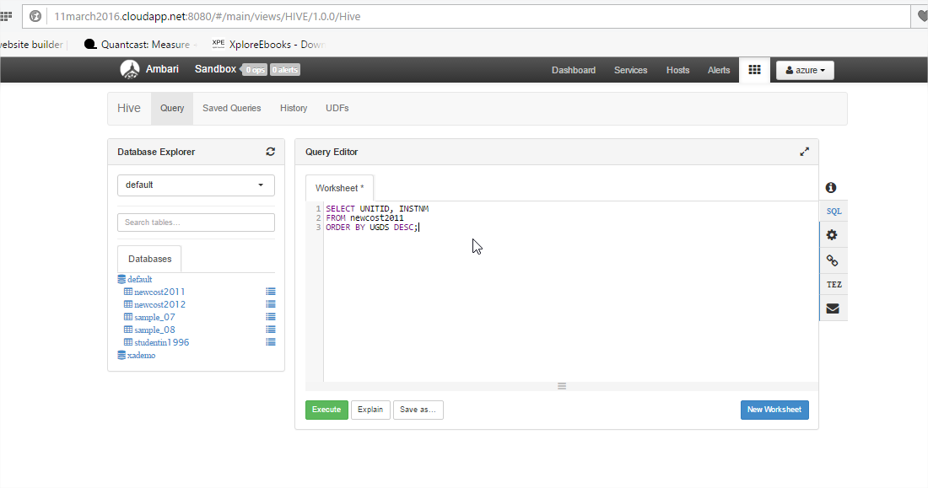
HIVE Query FOR SORTING DATA

Slide 24
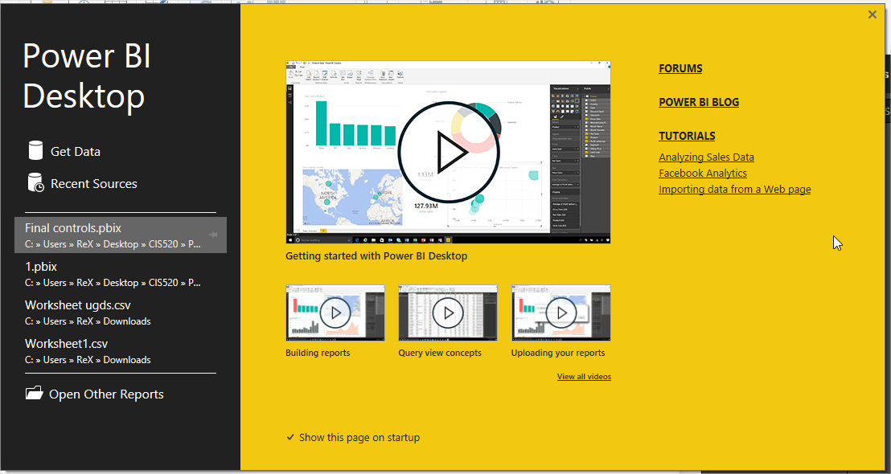
MICROSOFT POWER BI USED FOR DATA ANALYSIS

Slide 25
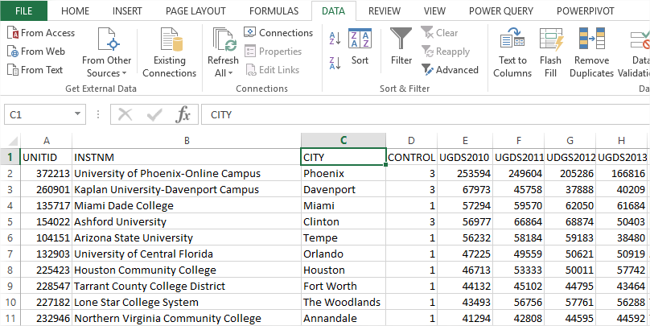
COMBINING THE RESULT QUERY together For analysis

Slide 26
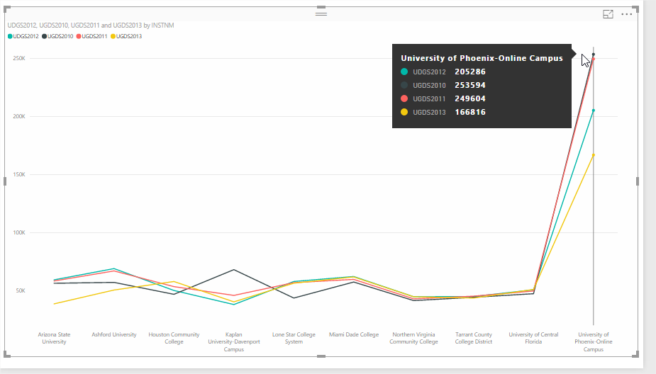
Graphical Representation using POWER BI

Slide 27
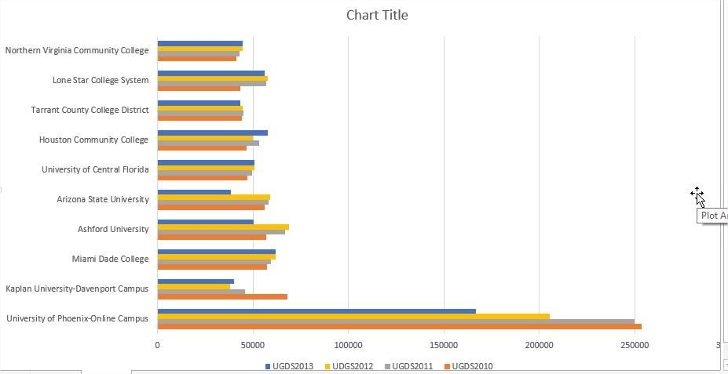
Graphical Representation using POWERVIEW

Slide 28
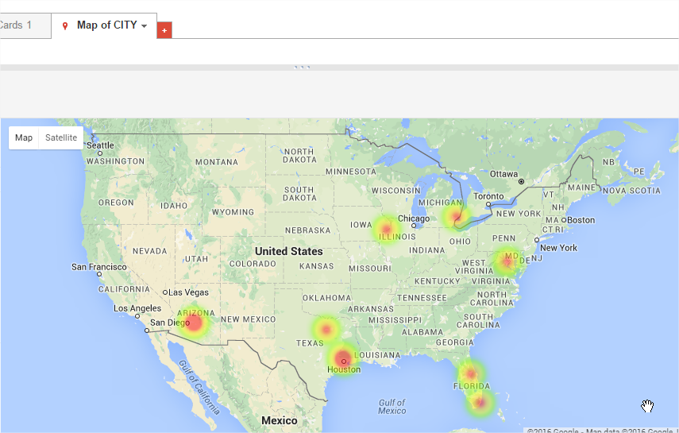
Graphical Representation using Google Fusion Tables

Slide 29
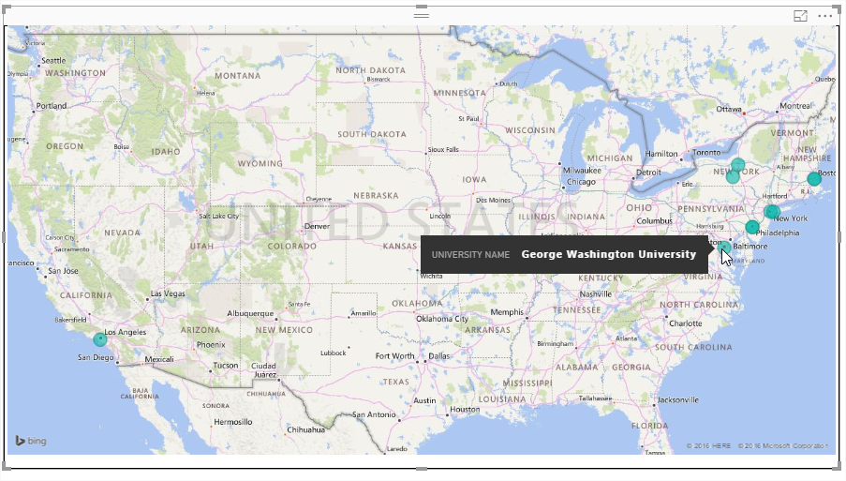
Graphical Representation using Power BI MOST COSTLY UNIVERSITY IS IN EAST COST

Slide 30
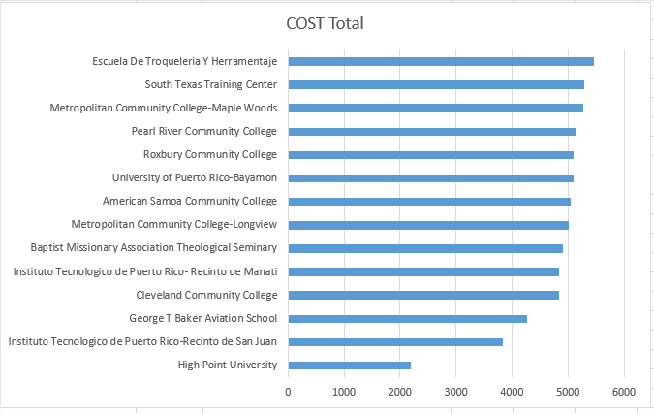
OVERALL INEXPENSIVE College

Slide 31
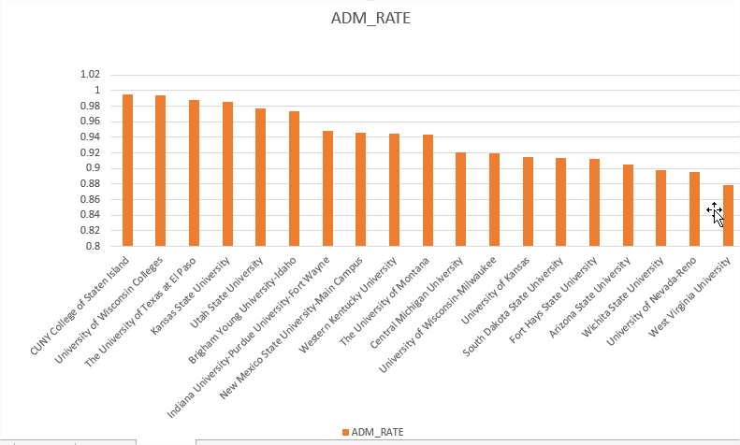
Best Admit rates Among colleges

Slide 32
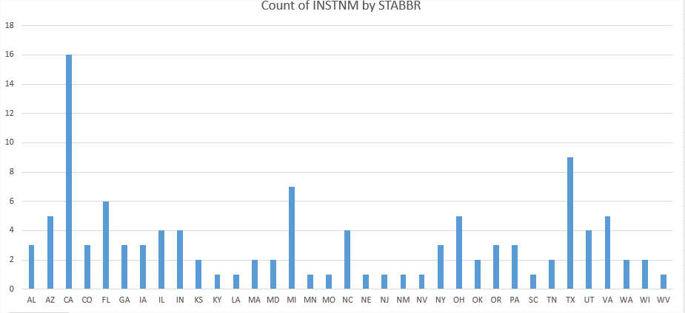
conclusion

Slide 33
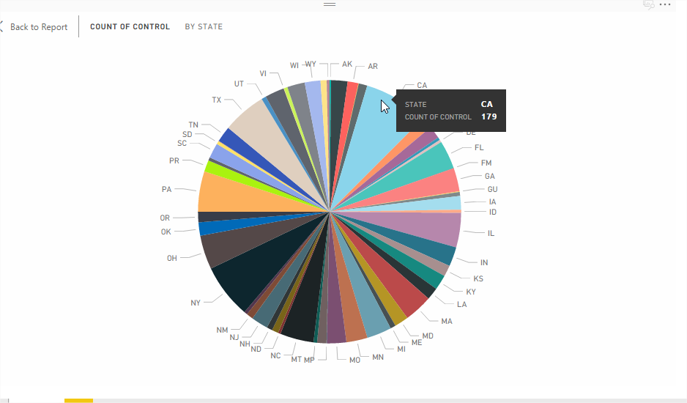
Sate with highest number of university

Slide 34
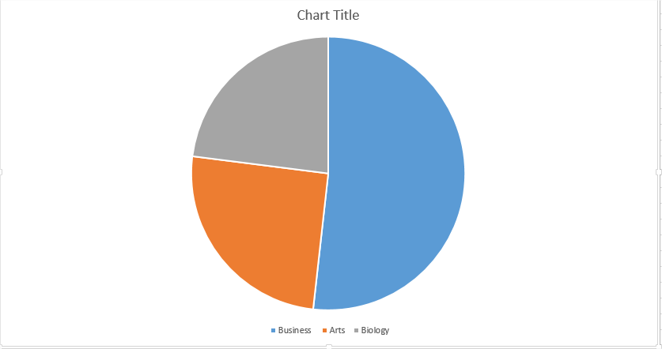
Most Popular college Majors

Slide 35
CONCLUSION
COSTLIET UNIVERSITY is NEW YORK UNIVERSITY
Most of costly university are located in east cost i.e. New York and nearby area
BIGGEST UNIVERSITY of Phoenix-Online Campus
Biggest Major Is business.
STATE WITH MOST UNIVERSITY WITH 10000 student is California i.e. 16
CUNY College of Staten Island has highest admission rate i.e. its easiest to get admission here.
CHEAPEST College is High Point University

Slide 36
Link
Dataset Link: (Dataset Size – 1580 MB uncompressed)
http://catalog.data.gov/dataset/college-scorecard

Slide 37
REFERENCE
https://azure.microsoft.com
www.Data.gov
http://www.lynda.com/Hadoop-tutorials/
http://www.tutorialspoint.com/big_data_tutorials.htm
http://searchstorage.techtarget.com/guides/Big-data-tutorial-Everything-you-need-to-know

Slide 38
THANK YOU
ANY QUERIES?

